Slide 1
TailorNet GUI
Scott Jacobsen – wjj170030
Rushmitha Aluka – rxa200038

Slide 2
Table of contents:
Problem Summary
Description of Work
Results
Analysis of Work
Comparison
Screenshots of GUI

Slide 3
Problem Summary:
TailorNet seeks to predict the deformation of different clothing garments when worn by people of varying shape and poses.
The problem it tackles is important because the current solutions for clothing simulation were very limited.
The ability to quickly, easily, and accurately visualize how clothing will look on various body types can be useful in a number of applications, for example a digital fitting room.

Slide 4
Description of Work
For this project, we developed a front end for TailorNet.
With our webpage, users can easily tweak TailorNet’s parameters and view the results.
When setting out to develop this we ran into a couple of roadblocks.
Initially we were trying to do our development work on Windows, but we switched to Linux early on.
Another challenging part of this project was the webserver we were using timing out during rendering, which we fixed with some settings changes.
The last difficulty we ran into was a result of having too new of a version of scipy.

Slide 5
Results
We have created a web based GUI that users can interact with to tweak the TailorNet parameters and view the result.
This required configuring a server to be able to properly run TailorNet, which wound up being a non-trivial task. The available parameters to play with are gender, garment type, garment style, body shape, and pose sequence of the prediction.
Once the user has chosen their desired parameters, they can submit to the server. The server will then run the prediction with the given parameters, render the result into an mp4 video with ffmpeg and blender, and return the video results to the client.

Slide 6
Analysis of Work
Ablation Study:
TailorNet has a novel way of dealing with the over smoothing problem present in other solutions
Additionally, TailorNet splits the deformation of the clothing as those due to pose, shape, and style, and the deformations due to articulation.

Slide 7
Ablation Study:
The TailorNet GUI we developed has an endpoint for displaying the GUI, an endpoint for inferring the garment deformations, and an endpoint for rendering the results.
The TailorNet source files required minimal changes, with the only modifications made being to take prediction parameters from the command line and set environment specific variables.

Slide 8
Comparison:
Our addition of a GUI makes playing with the parameters of TailorNet much easier.
Before our changes, running the prediction with different parameters required editing the correct lines of run_tailornet.py. Now, the user only needs select the parameters they want and click submit.
The base TailorNet, however, has some output options that are not supported by the GUI, for instance the rendering of single frames.
The main upside of this GUI is it allows anyone to try TailorNet without them needing to set it up locally.

Slide 9
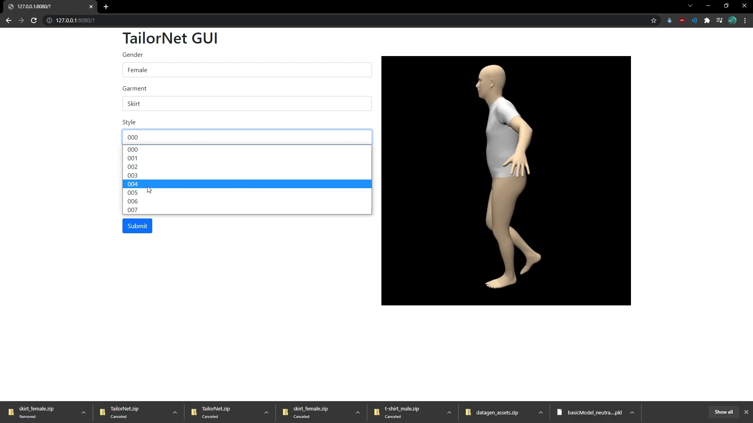
Screenshots of GUI: before

Slide 10
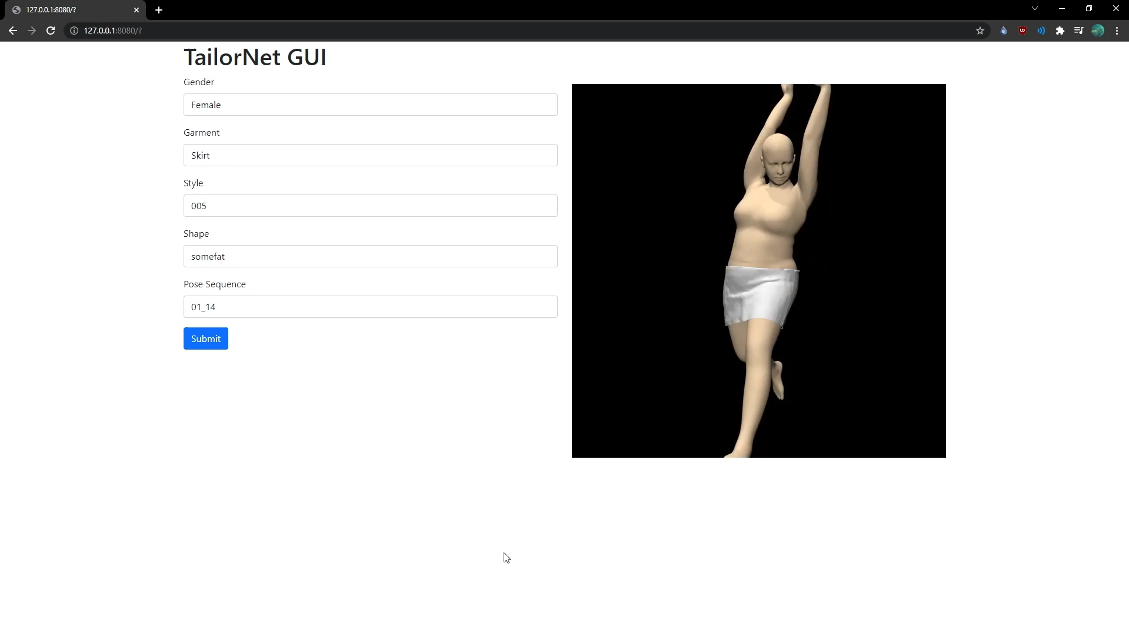
After submitting the desired requirements:

Slide 11
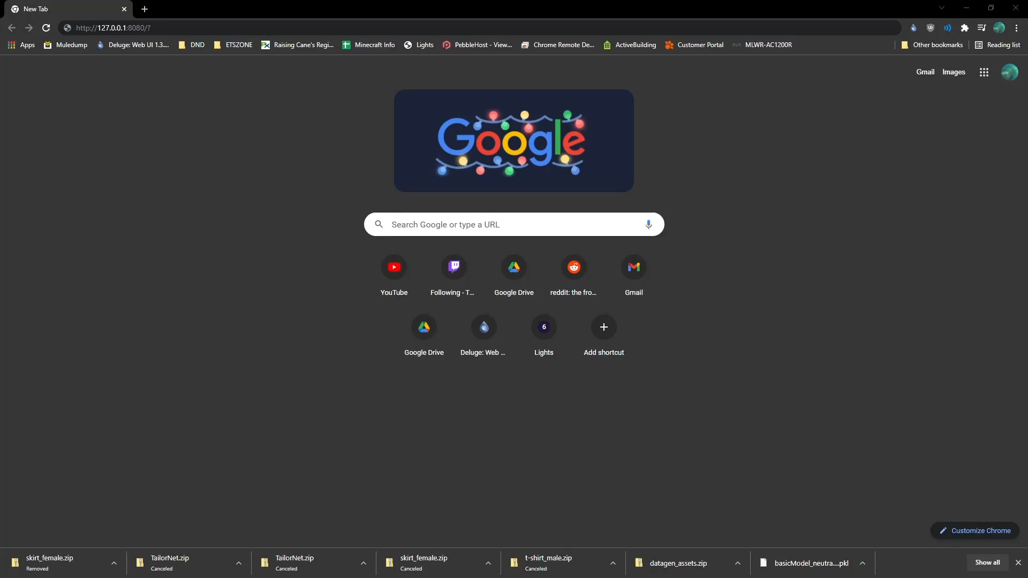

Slide 12
THANK YOU!!

